Slide 1
DemoSat High Altitude
Balloon Payload
Final Project | ENCE 3231 Microprocessors 1 | Winter Quarter 2026
Angel F. Avila
University of Denver | COSGC | KEEN EML
NASA Colorado Space Grant Consortium | DU Daniel Felix Ritchie School of Engineering & Computer Science

Slide 2
PROJECT OVERVIEW
COSGC
KEEN EML
This Project
The NASA-funded Colorado Space Grant Consortium connects 12 Colorado colleges on real space engineering projects including the DemoSat balloon payload program.
The Kern Entrepreneurial Engineering Network fosters Curiosity, connections, and the creation of value alongside technical skills to build entrepreneurial engineers.
Bridge both initiatives: evaluate the current DemoSat sensor kit, then propose an alternative design that meets all requirements under cost & weight limits.
GOAL: Evaluate the current DemoSat kit and design an alternative that maintains full functionality within cost & weight constraints.

Slide 3
PHASE 1: SYSTEM EVALUATION
Old Board: Component Inventory
Microcontroller
Arduino Uno
Data Logger
OpenLog (serial TX1, micro SD)
Accelerometer
ADXL335 (±3g, analog, A4/A5)
Internal LEDs
Red D7 · Yellow D9 · Blue D6 · Green D5
Pressure Sensor
SSCDANN015PGAA5 (analog, A3)
External LEDs
Orange D4 · Blue D3
Humidity Sensor
HIH-4030/31 (analog, A2)
330Ω Resistors
6 total (LED current limiting)
Ext. Temp Sensor
TMP36 – External (analog, A1)
Power
9V Battery
Int. Temp Sensor
TMP36 – Internal (analog, A0)
Connectors
2-pin, 3-pin, 4-pin, 6-pin headers
LED Functions
Red (DD7) — IMU
Green (DD5) — External Temp
Yellow (DD9) — Pressure
Orange (DD4) — Internal Temp
Blue (DD6) — Humidity
Blue (DD3) — Arduino Power

Slide 4
PHASE 1: BLOCK DIAGRAM (ORIGINAL SYSTEM)
Ext. Temp
TMP36 (A1)
A1
OpenLog
(SD Card, TX1)
Int. Temp
TMP36 (A0)
A0
LEDs x6
(D3–D7, D9)
Humidity
HIH-4030 (A2)
A2
Arduino Uno
(MP)
9V Battery
(Power)
Pressure
SSCDAN (A3)
A3
Accelerometer
ADXL335 (A4/A5)
A4/A5
⚠ Unavailable components: HIH-4030/31 Humidity Sensor · SSCDAN Pressure Sensor · ADXL335 Accelerometer

Slide 5
PHASE 1: POWER & WEIGHT ANALYSIS
Power Consumption per Component
Weight Breakdown
Arduino Uno
50 mA
Arduino Uno
7g
SD Card
Accelerometer
10g
80 mA
Pressure Sensor
5g
LEDs (×6)
10 mA
Humidity Sensor
25g
Pressure
1.5 mA
Temp Sensors ×2
20g
Humidity
1 mA
SD Card
2g
Temp ×2
1 mA
LEDs+Resistors
1g
Accelerometer
0.5 mA
Battery + PCB
77g
TOTAL: 146 mA
TOTAL: ~147g

Slide 6
PHASE 2: ALTERNATIVE DESIGN
Design Requirements
💰 Cost
≤ $147 total (lower preferred)
⚖️ Weight
≤ 200g maximum payload
⚡ Power
Lower consumption than 146mA
📡 Functionality
Temp (int/ext), humidity, pressure, 3-axis accel, LEDs, SD storage
These must all be replaced.
🔌 PCB
Custom PCB design

Slide 7
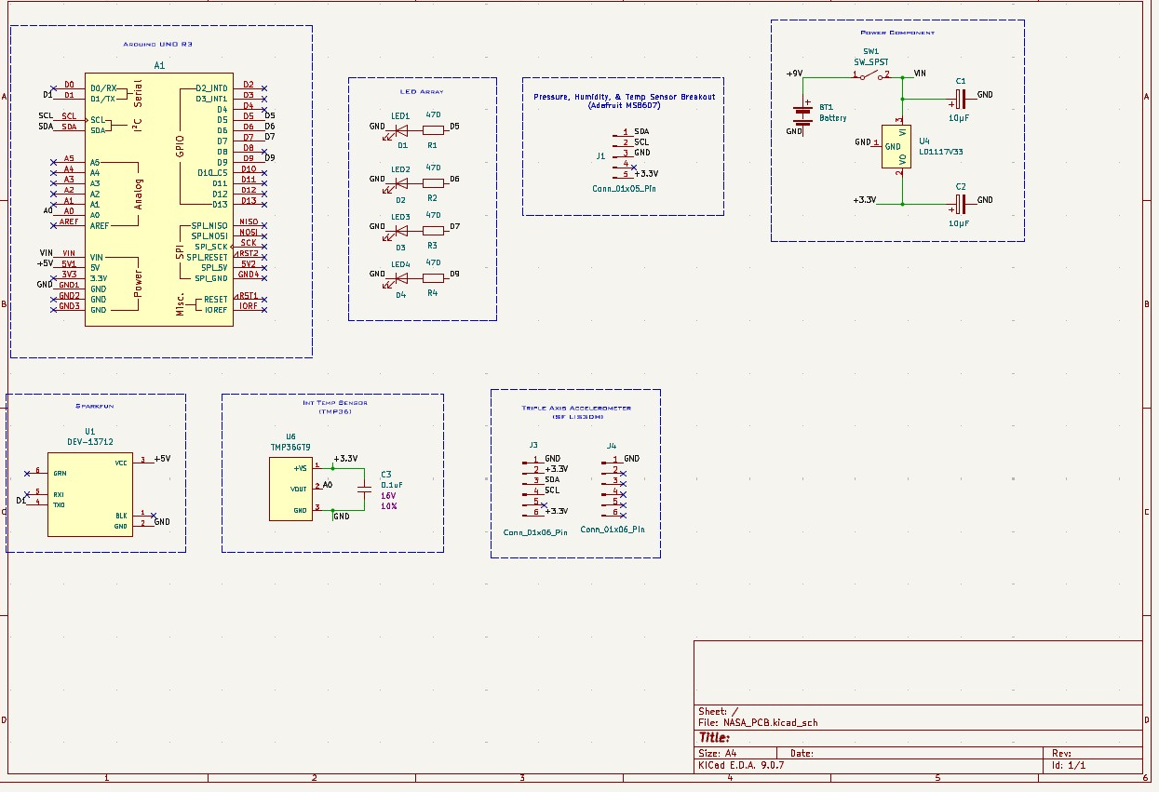
PHASE 2: SCHEMATIC DESIGN
📷 INSERT SCHEMATIC SCREENSHOT HERE
KiCad Schematic Editor → File → Export → SVG or take a screenshot
Arduino
Uno R3
Adafruit
HSB007
SparkFun
LIS3DH
TMP36GT9
Int. Temp
SparkFun
DEV-13712
OpenLog
SD Card

Slide 8
PHASE 2: SYSTEM BLOCK DIAGRAM
Adafruit HSB007
Pressure/Humidity/Temp
OpenLog
SD Card Data Logger
I2C
A4/A5
TX1
TMP36GT9
Internal Temp (A0)
A0
LED Array ×4
Status Indicators
Arduino Uno R3
(Microcontroller)
D5–D9
SparkFun LIS3DH
Triple Axis Accel
I2C
A4/A5
SparkFun
DEV-13712 Module
D4/D5
9V Battery
Power Supply
VIN
Power Circuit
LD1117V33 + Caps
3.3V
Adafruit HSB007 and SparkFun LIS3DH both use I2C (A4/A5 shared bus). TMP36GT9 uses analog A0. SparkFun DEV-13712 connects via digital pins.

Slide 9
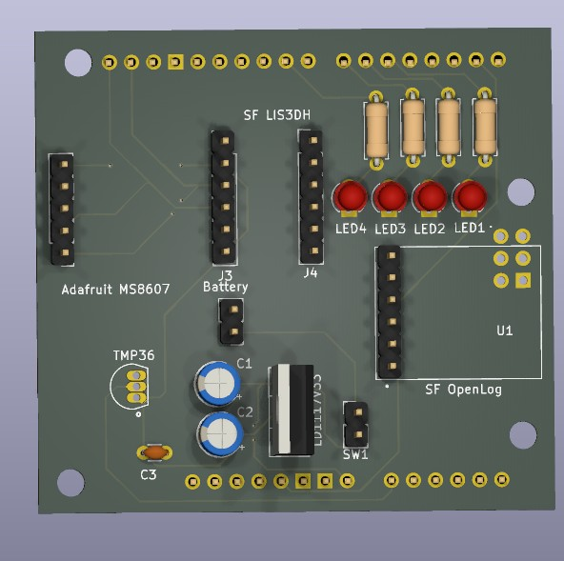
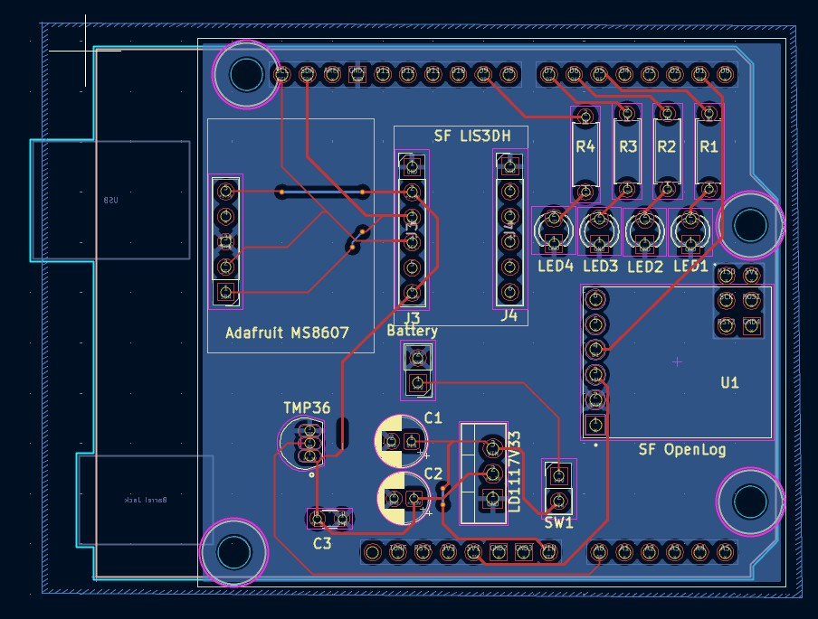
PHASE 2: PCB DESIGN
FRONT / TOP LAYER
3D RENDER
📷 INSERT PCB FRONT VIEW
KiCad PCB Editor → 3D Viewer
or screenshot of layout
📷 INSERT PCB 3D VIEW
KiCad PCB Editor → View → 3D Viewer
Press Ctrl+3
Est. Cost
Manufacturer
OSH Park (USA)
~$28–35 for 3 boards

Slide 10
PHASE 2: BILL OF MATERIALS & ANALYSIS
Bill of Materials
Key Metrics
Component
Part
Cost
Power
Weight
Total Cost
Microcontroller
Arduino Uno R3
$20
50mA
25g
~$118
Pressure/Humidity/Temp
Adafruit HSB007
$15
3mA
5g
Triple Axis Accel
SparkFun LIS3DH
$15
0.5mA
5g
✓ Under $147 budget saves ~$29
Internal Temp
TMP36GT9
$2
1mA
5g
Total Power
Module
SparkFun DEV-13712
$25
10mA
15g
~155mA
Data Logger
OpenLog (SD Card)
$15
80mA
2g
LEDs ×4 + Resistors
470Ω, misc
$3
10mA
1g
All sensors active
Power Circuit
LD1117V33, caps, switch
$8
—
10g
9V Battery
Standard alkaline
$5
—
45g
Total Weight
~133g
Custom PCB
PCBNet — USA made
$10
—
20g
TOTAL
~$118
~155mA
~133g
✓ Under 200g limit 67g margin
PCBNet (pcbnet.com), USA-manufactured, $10/board, Free FedEx Ground shipping, 2-layer FR4, Accepts KiCad Gerber files

Slide 11
CONCLUSION
Phase 1
Documented all components, mapped pin assignments, computed 146mA power draw and ~147g total weight. Identified 4 unavailable parts blocking production.
Phase 2
Designed an alternative PCB using the same sensor suite: HIH-4030/31, SSCDAN, ADXL335, TMP36 ×2, SparkFun DEV-13712, and OpenLog. Custom KiCad shield PCB keeps full functionality under $147 budget and under 200g weight limit.
Angel F. Avila · ENCE 3231 Microprocessors 1 · University of Denver · Winter 2026

